Slide 1

Movie match for android A penny for your thoughts ltd.
By: Matthew Penny

Slide 2
Project Timeline
JUNE 2022
After finishing courses, a proposal was put together, submitted to the school and accepted in time to start the implementation.
JULY 2022
The planning stages took the first few weeks, then into coding, testing and many prototype iterations. Documentation began near the end of the month.
AUGUST 2022
Documentation was finalized, stakeholder presentation built, and final bugs were worked on. Application not ready for the Play Store but large leaps in learning were earned.

Slide 3
Application Description
<<NEEDS WORK>>We now have many options for what to watch, devices to watch them on and at times, it can seem like you’ll never agree with your partner, friends or family members on what to watch. Well, stress no more, the Movie Match application will solve that issue for you!

Slide 4
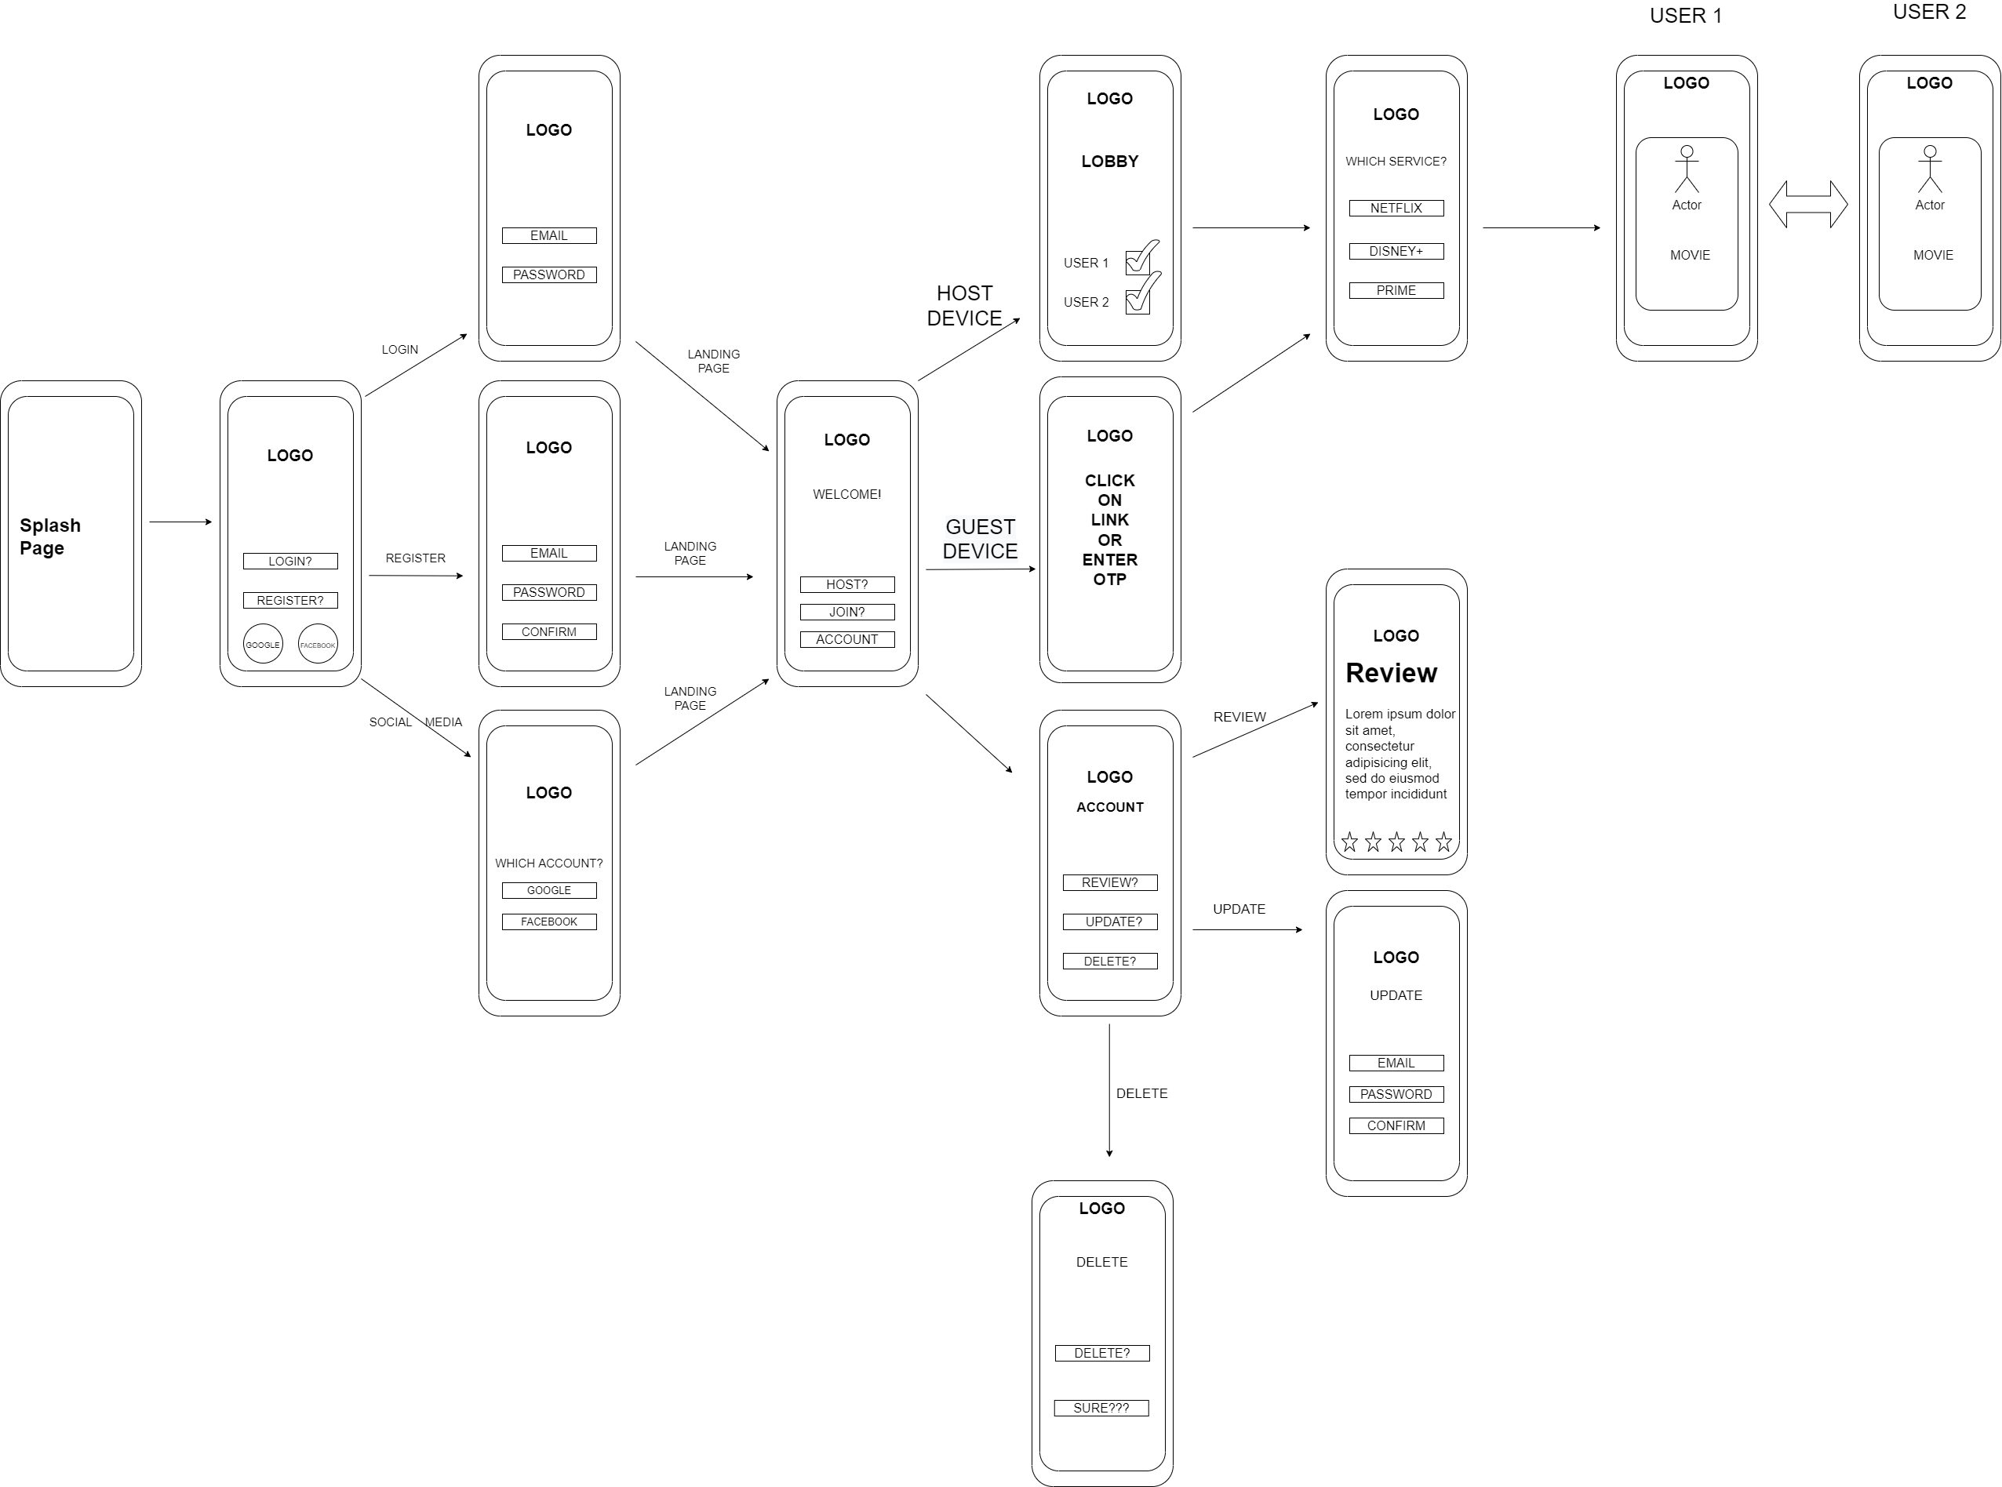
Wireframe Diagram

Slide 5
DATABASE & CARDINALITIES

Slide 6
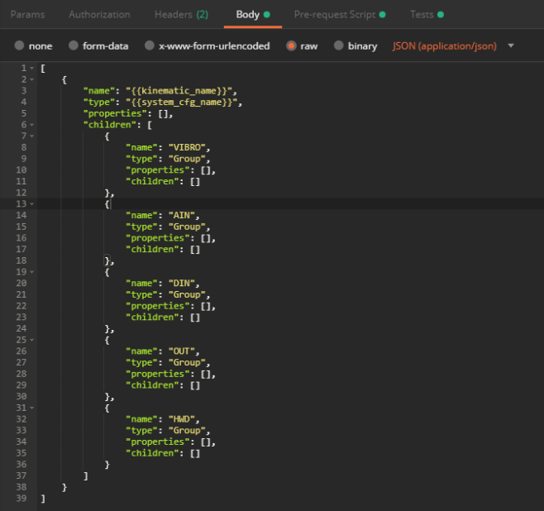
Database Design & Format
We used Firebase for our Database needs, as the fluidity allowed us to make changes on the fly as creating and displaying matches was a large roadblock during the SDLC. Firebase tables are more closely related to JSON trees than a traditional SQL table, which both helped and hindered us during the implementation of the project. Due to a change from the original idea, there are two sets of diagrams.

Slide 7
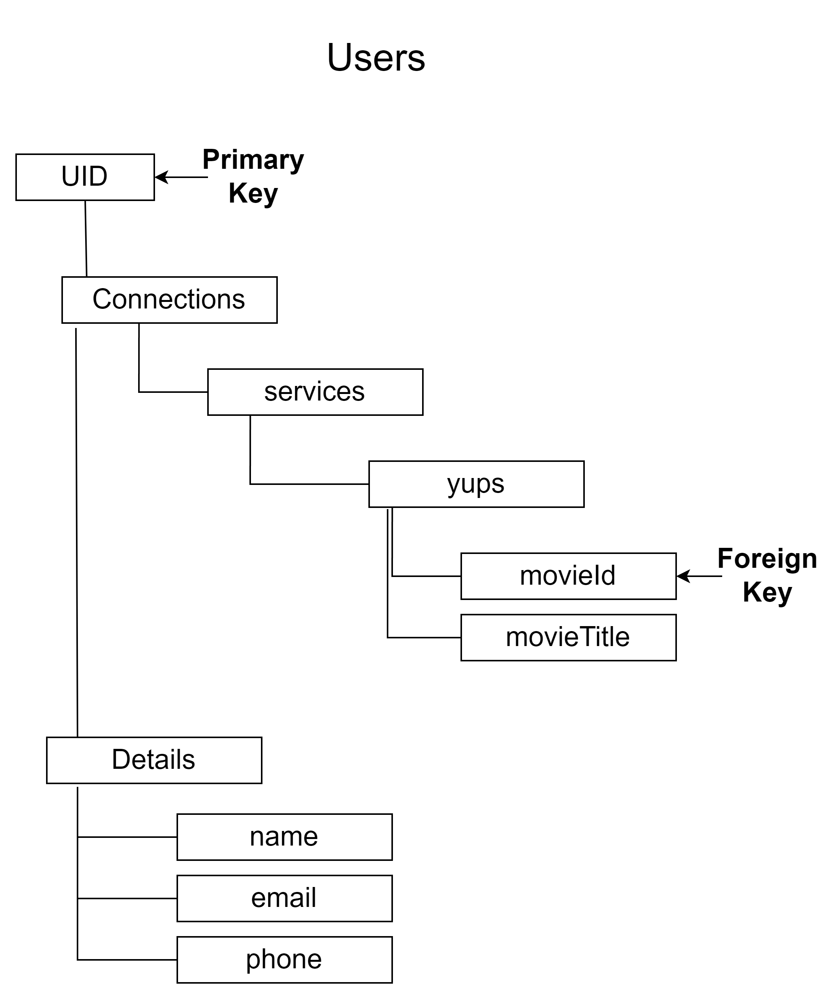
Original JSON Data Tree
UID (User ID) - Generated automatically by Firebase, makes a great PK as it has a unique value.
Connections – Holds all services, as well categorizing the movies confirmed as well as an ID for reference.
Details – Contains all user details

Slide 8
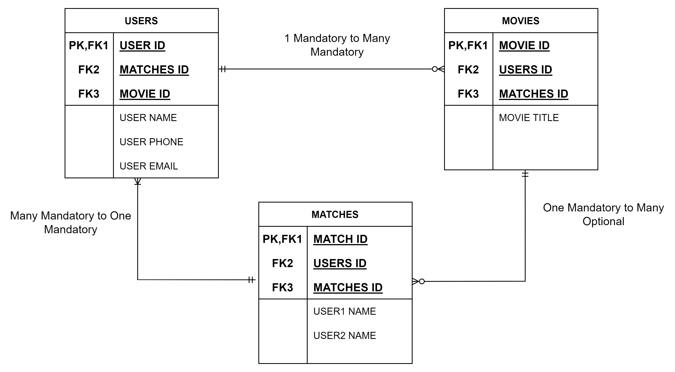
Original Database Cardinalities

Slide 9
Original Database Cardinalities
We looked at the different cardinalities for our project and produced the following set:
Users – One Mandatory to Many Mandatory in relation to Movies table, Many Mandatory to One Mandatory in relation to Matches table.
Movies – Many Optional to Many Optional in relation to Users table, One Mandatory to Many Mandatory in relation to Matches tab
Matches – One Mandatory to Many Mandatory in relation to Users table, Many Optional to One Mandatory in relation to Movies table.

Slide 10
Original Database Design

Slide 11
Firebase Tree Designs

Slide 12
Movie match for android A penny for your thoughts ltd.
By: Matthew Penny

Slide 13
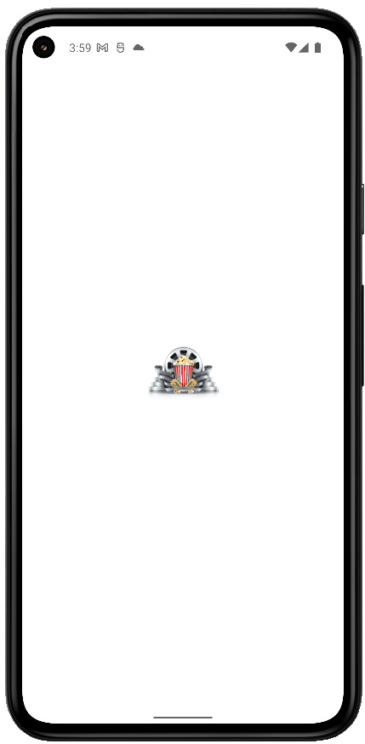
Launch Screen
While launching, we treat the users to the Movie Match logo, with which we hope to invoke some feelings of a few decades ago when theatres were the way to go for a group viewing experience.

Slide 14
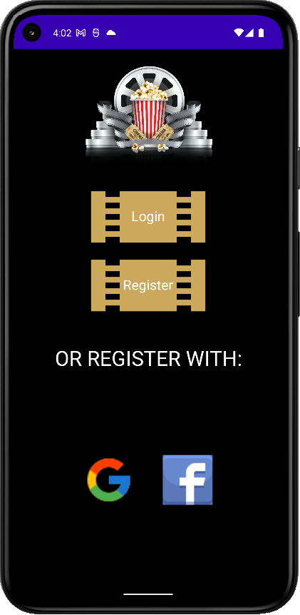
Landing Screen
Landing page shows the login options and will allow users to register using Google, Facebook or the application’s own Firebase authorization by using email and password.

Slide 15
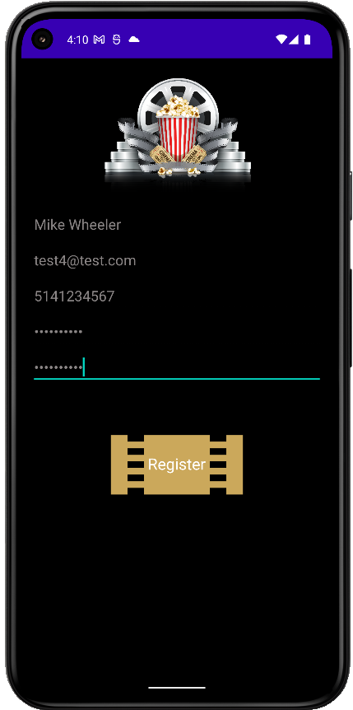
Register Screen
<<NEEDS WORK>>Allows registration through Firebase and email/password validation.

Slide 16
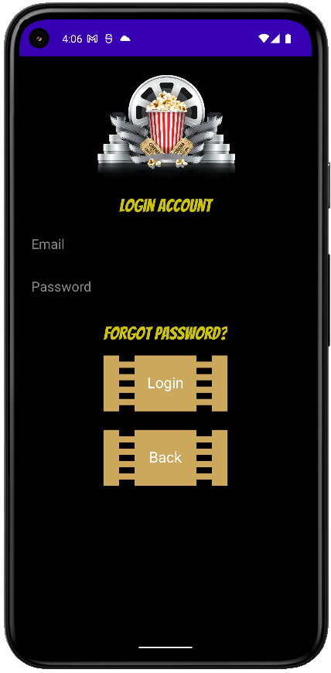
Login Screen
(With Account) Can login here or if need be, can reset password for the application.

Slide 17
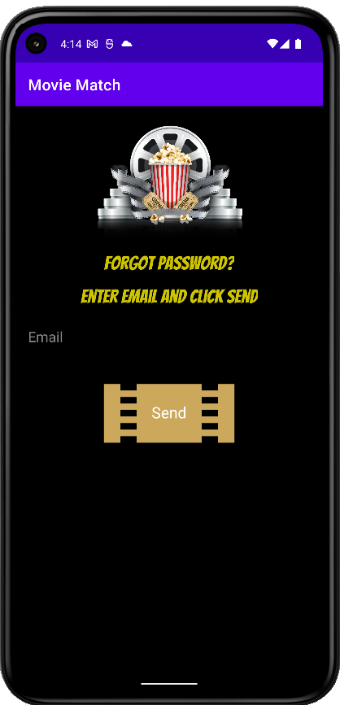
Forgot Password Screen
<<NEED TO REDO PICTURE BC OF ACTION BAR>>

Slide 18
Movie match for android A penny for your thoughts ltd.
By: Matthew Penny

Slide 19
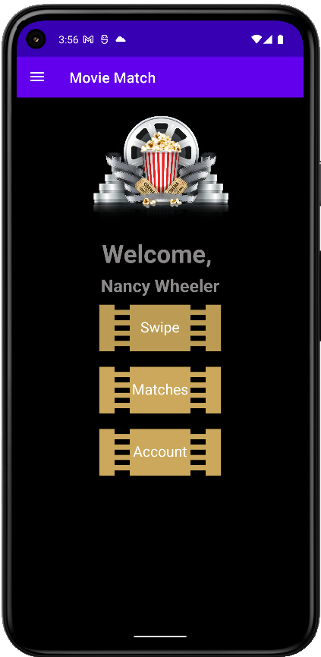
Welcome Screen
From here, we can start move through the main stages of the application in all it’s glory!
Swipe does this…
Matches does that…
Account does the other thing…

Slide 20
Service, Genre & Type Screen

Slide 21
Swipe Screen

Slide 22
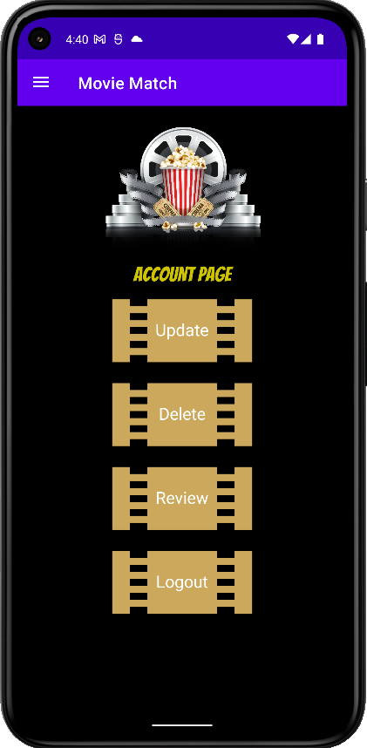
Account Screen
This activity allows the user to:
Update…
Delete…
Review…
Logout…

Slide 23
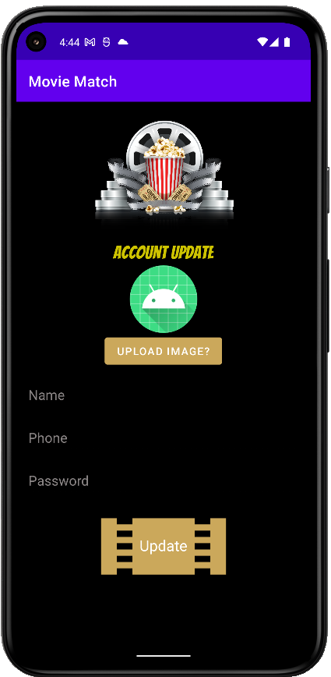
Account Update Screen
The user can update their account information to ensure they appear to their matches as they wish. As well, they can upload an image from their device for other users to see.

